Slide 1
‘Welcome to Year 2’ Information for Parents/Carers of children in Year 2

Slide 2
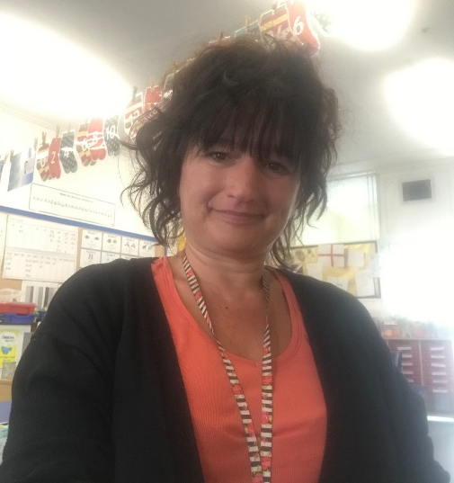
Who’s who?
Mr Woodgates – Class teacher
Miss Kennedy – Teaching assistant
Mrs Coombes – Teaching assistant
Mr Twynam – PPA teacher (Friday Morning)

Slide 3
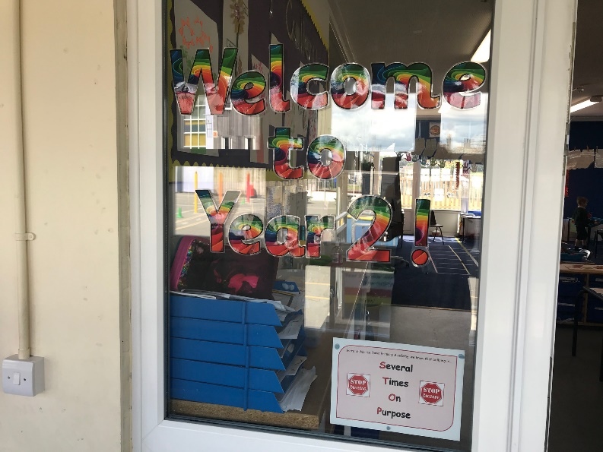
Where are we?
This is where you will come into our class.
This is still our classroom door.

Slide 4
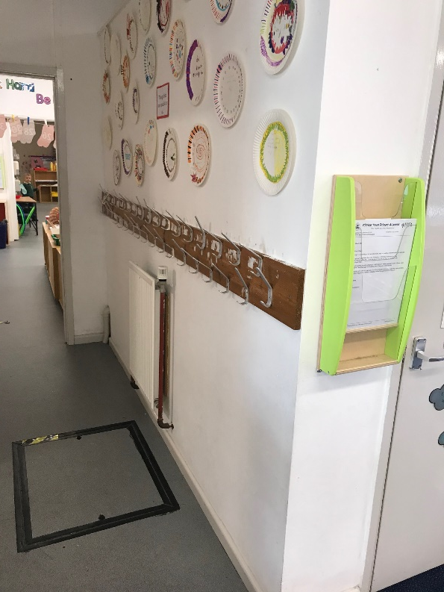
Where are we?
This is our classroom.
This is where our coats and bags go.

Slide 5
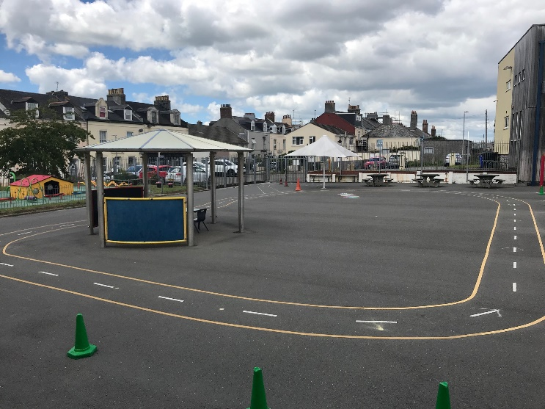
Where are we?
These are still your toilets.
Here is where you will play.

Slide 6
Topics
Term 1 & 2: Fire, Fire
Terms 3 & 4: Brilliant Britain
Terms 5 & 6: Our World

Slide 7
Homework
Knowledge organisers
These will be used to help the children learn the knowledge about our topics.

Slide 8
During every English and Maths session the children will work in groups with an adult, in pairs or independently.
Phonics is taught daily by one of the adults in the Year 1 & 2 bubble: Mr Woodgates, Miss Rood, Mrs Webb, Miss Kennedy or Mrs Penney. We are using Read Write Inc.
Every child will Read In Class in ERIC and will happen every day.

Slide 9
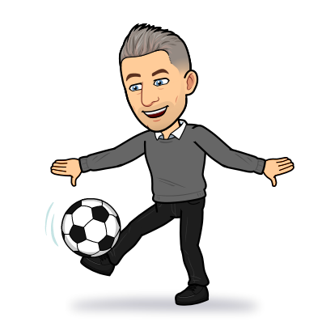
PE is every Tuesday and Wednesday afternoon.
Currently the children will not need kits, just trainers.
Book bags need to be in school everyday please.

Slide 10
Home Reading
Children will expected weekly to read daily.
3 books will go home:
1 RWI book they are reading in phonics.
1 RWI book bag book.
1 Reading for pleasure book.
Reading books will be changed regularly when the children have read their book three times. This allows for them to increase their fluency and allows us to monitor their progress. If you read with your child, or they read to you, please record it in their diary.

Slide 11
Home Learning
Home Learning will be set at the beginning of each term and should be handed in when it is completed.
Homework will consist of a variety of tasks such as a topic project, writing or maths problem solving tasks.

Slide 12
Rewards
Rewards:
For following our Year 2 Golden Rules for Learning are given in the form of Golden Tickets.
Every Friday there is a Golden Ticket Raffle Draw and two winners gets a prizes.
For great pieces of work children will earn stickers and prizes.
Every time your child has read at home 10 times they will climb the ladder and receive a prize.
Star of the week will be picked at the end of the week and will also win a prize.
Headteacher’s award will be given for exceptional work a high standard of presentation.

Slide 13
Website
Check out our website where we will be putting up home learning tasks, pictures and videos of the children’s learning throughout the year, as well as trips we attend.
http://www.moricetownprimary.co.uk/website/year_2/388340

Slide 14
SATs Tests
The children will be taking their KS1 SATs tests throughout May.
There will be:
Two reading papers.
Combined reading prompt.
Reading booklet and separate answer booklet
Two maths papers
Arithmetic
Reasoning
Two English, grammar, punctuation and spelling papers
A Spelling paper
A Grammar and punctuation paper

Slide 15
SATs Tests
The children will be doing lots of practise in class and in early morning tasks.
We will make sure that it is as painless as possible but will expect the children to work hard.
Children’s writing will be assessed through writing tasks completed in class.

Slide 16
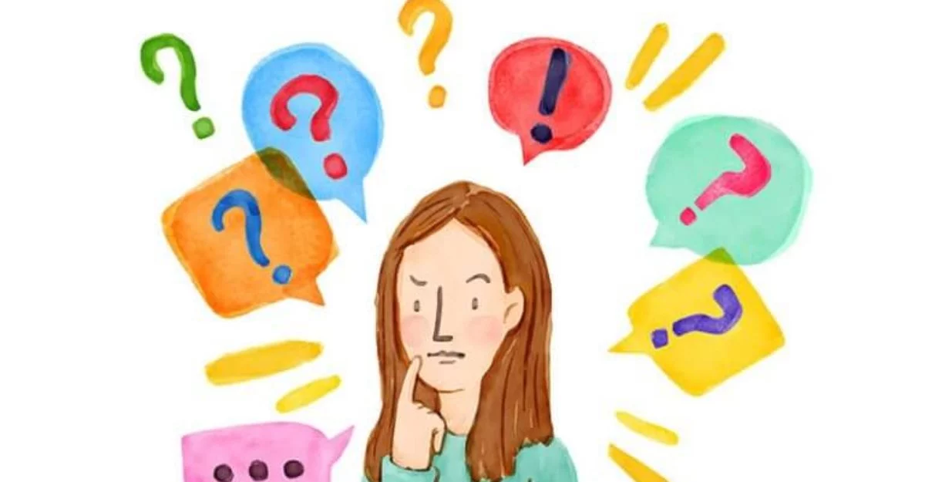
Any questions
year2@moricetownprimary.co.uk

Slide 17
We look forward to seeing you all in September. See if you can complete any of these challenges before you come back:
Read a book with someone at home.
Count to 100 and backwards again!
Bounce a ball for 30 seconds.
Can you do it on one leg?
Write a diary entry about your lockdown experience and bring it in to show me in September!

