Slide 1


Slide 3
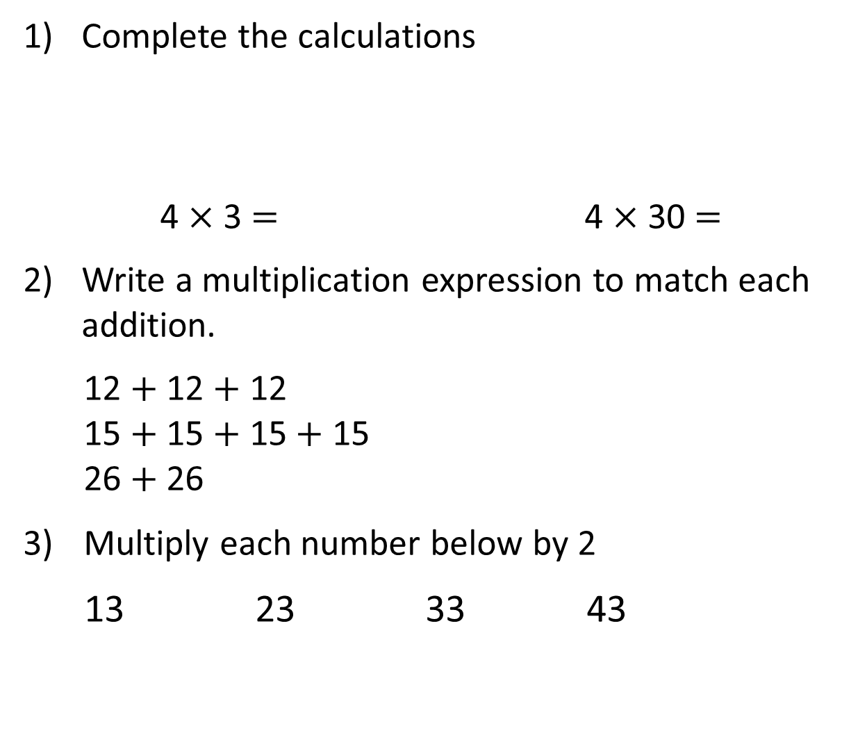
Complete the calculations
4 $×$ 3 $=$ 4 $×$ 30 $=$
Write a multiplication expression to match each addition.
12 $+$ 12 $+$ 12
15 $+$ 15 $+$ 15 $+$ 15
26 $+$ 26
3) Multiply each number below by 2
13 23 33 43

Slide 4
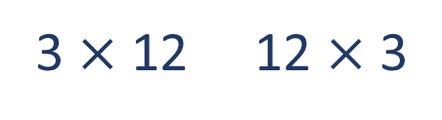
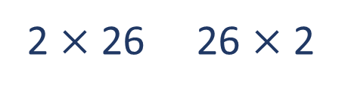
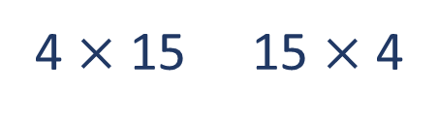
Complete the calculations
4 $×$ 3 $=$ 4 $×$ 30 $=$
Write a multiplication expression to match each addition.
12 $+$ 12 $+$ 12
15 $+$ 15 $+$ 15 $+$ 15
26 $+$ 26
3) Multiply each number below by 2
13 23 33 43
12
120
3 $×$ 12 12 $×$ 3
4 $×$ 15 15 $×$ 4
2 $×$ 26 26 $×$ 2
26
46
66
86

Slide 6
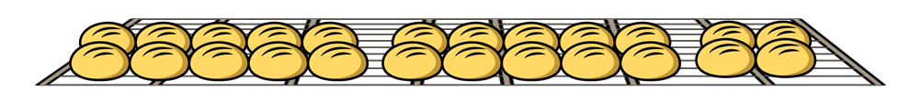
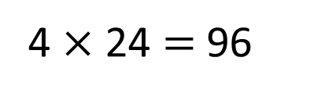
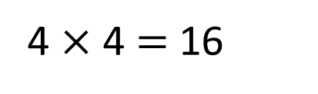
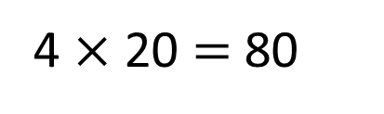
Each shelf has 24 rolls.
How many rolls are there in total?
24
4 $×$ 24 $=$ 96
20
4
There are 96 rolls in total.
4 $×$ 20 $=$ 80
4 $×$ 4 $=$ 16

Slide 7


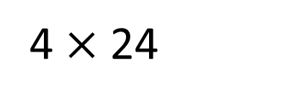
4 $×$ 24
T | O
T O
2
4
$×$
4
9
6
1

Slide 8


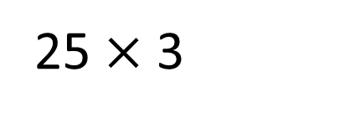
25 $×$ 3
T | O
Have a think
T O
2
5
$×$
3
7
5
1

Slide 9



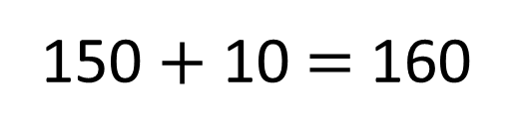
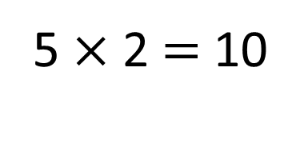
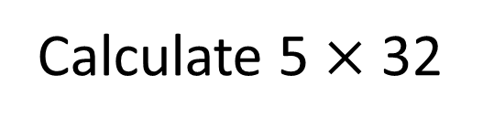
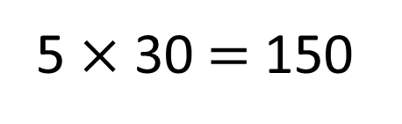
Calculate 5 $×$ 32
Have a think
H | T | O
5 $×$ 30 $=$ 150
5 $×$ 2 $=$ 10
150 $+$ 10 $=$ 160

Slide 10

Calculate 5 $×$ 32
H | T | O
H T O
3
2
$×$
5
1
6
0
1
1

Slide 11



Write a short multiplication to match the counters.
T | O
H T O
4
3
$×$
4
1
7
2
1
1
Have a think

Slide 12
Have a go at questions
1 - 6 on the worksheet

Slide 13


I placed the 3 digit cards into the calculation below.
My total was a multiple of 10
5
8
3
$$×$$
Have a think
How could Mo have arranged the cards?
Is there more than one way to make a multiple of 10?

Slide 14
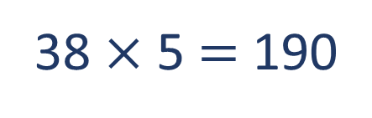
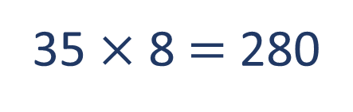
I placed the digit cards into the calculation below.
My total was a multiple of 10
5
8
3
$$×$$
35 $×$ 8 $=$ 280
2 8
0
38 $×$ 5 $=$ 190
1 9
How could Mo have arranged the cards?
Is there more than one way to make a multiple of 10?

Slide 15
Have a go at the rest of the questions on the worksheet

