Slide 2
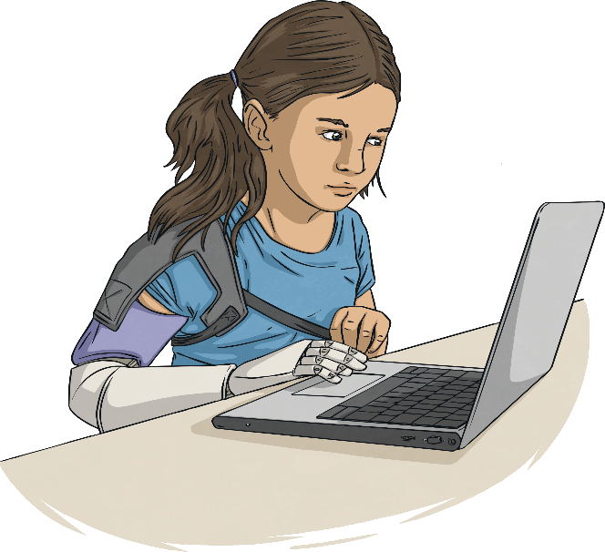
Aims
To know the purpose of the annual Safer Internet Day
To understand the theme, ‘Together for a better internet’
To understand my online identity and how to keep safe online

Slide 3
Word Check!
Let’s check your understanding of these key words:
internet
email
identity
online
avatar
app
messaging
profile

Slide 4
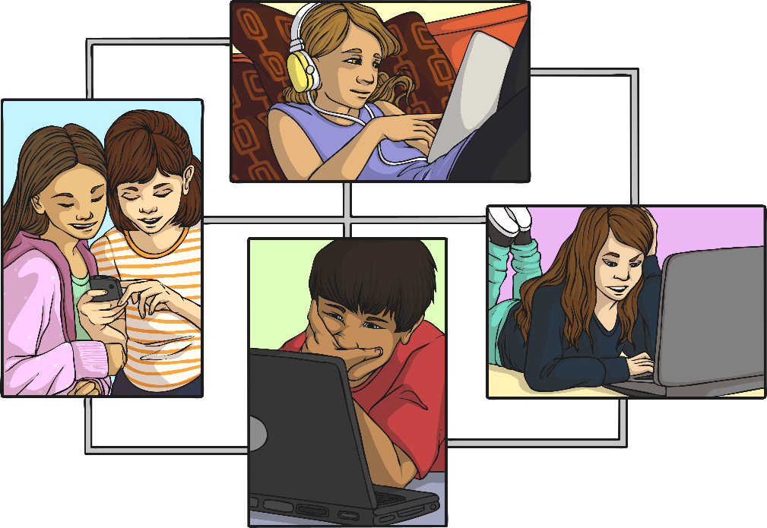
What Is Safer Internet Day?
Safer Internet Day is celebrated in over a hundred countries across the world on Tuesday 11th February 2020.
The theme this year is ‘Together for a better internet’.

Slide 5
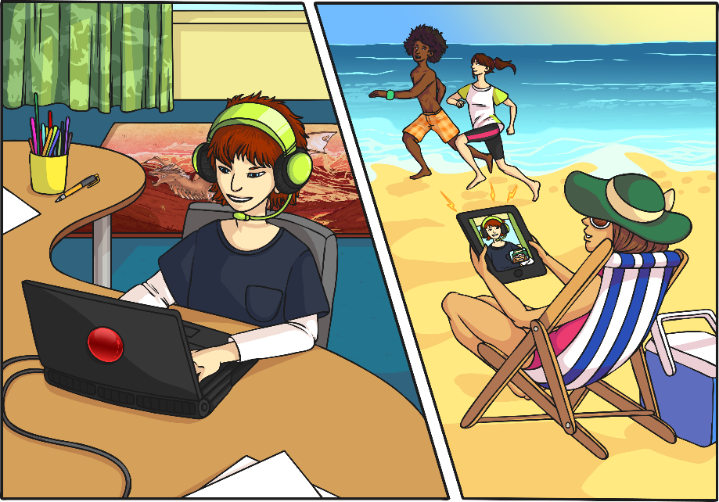
What Do You Use the Internet For?
The internet is an amazing place!
In our real lives, it provides us with entertainment, allows us to communicate and helps us learn new things.

Slide 6
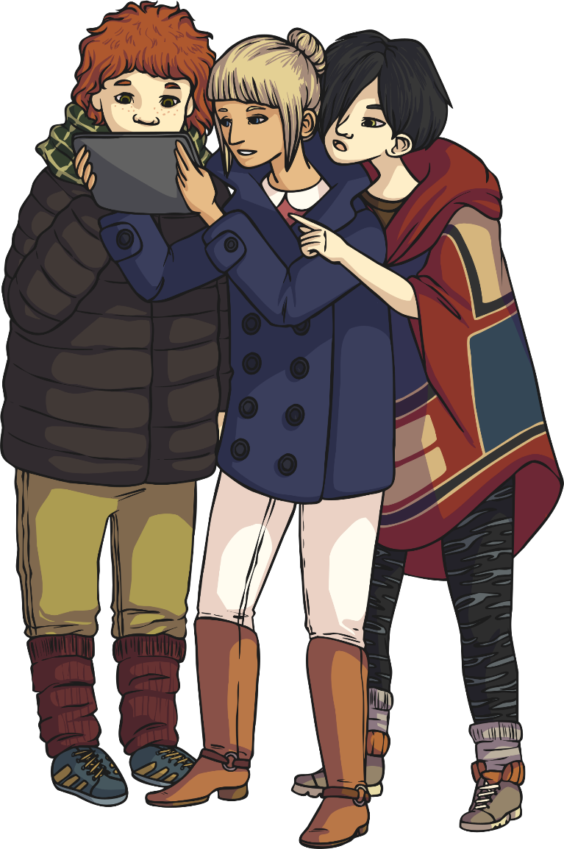
Who Can Use the Internet?
Can you think of examples of people who use the internet?
Many people across the world use the internet every day.
By the end of 2019, four and a half billion (4,500,000,000) people were using the internet. That is nearly 6 out of every 10 people in the whole world.

Slide 7
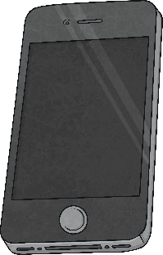
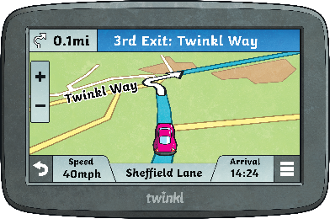
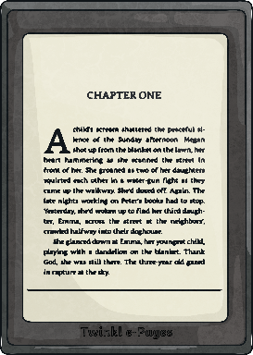
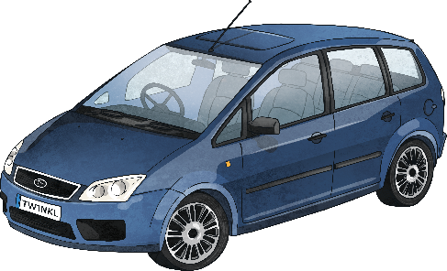
How Do We Access the Internet?
We can use lots of different devices to access the internet.
How many can you think of?
Did you think of all these?

Slide 8
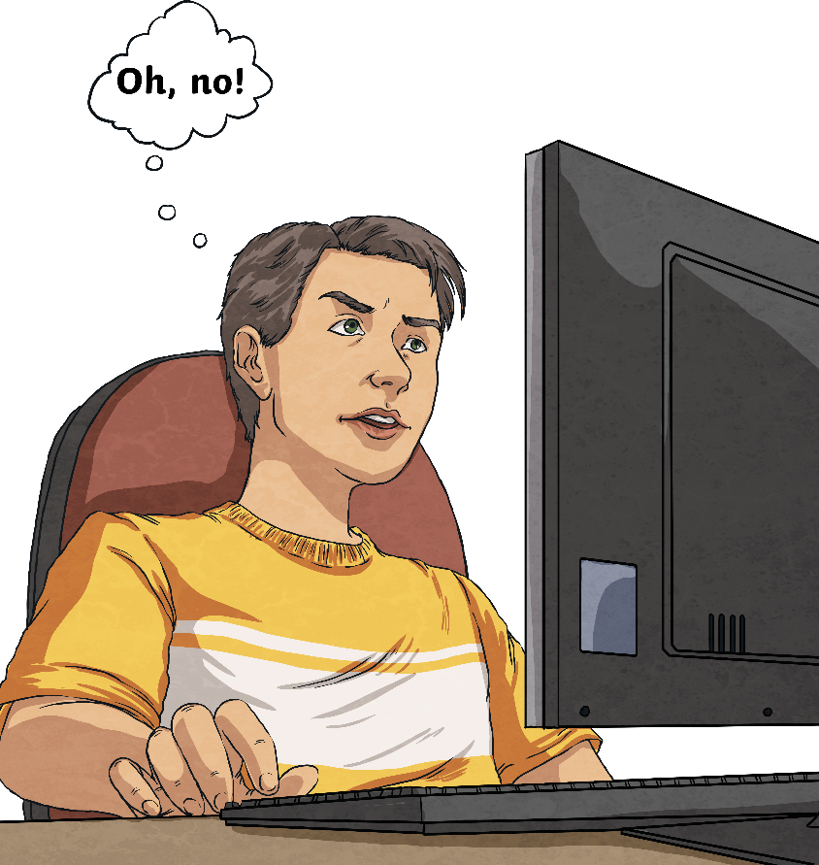
How Would You Feel if the Internet Was Turned Off?

Slide 9
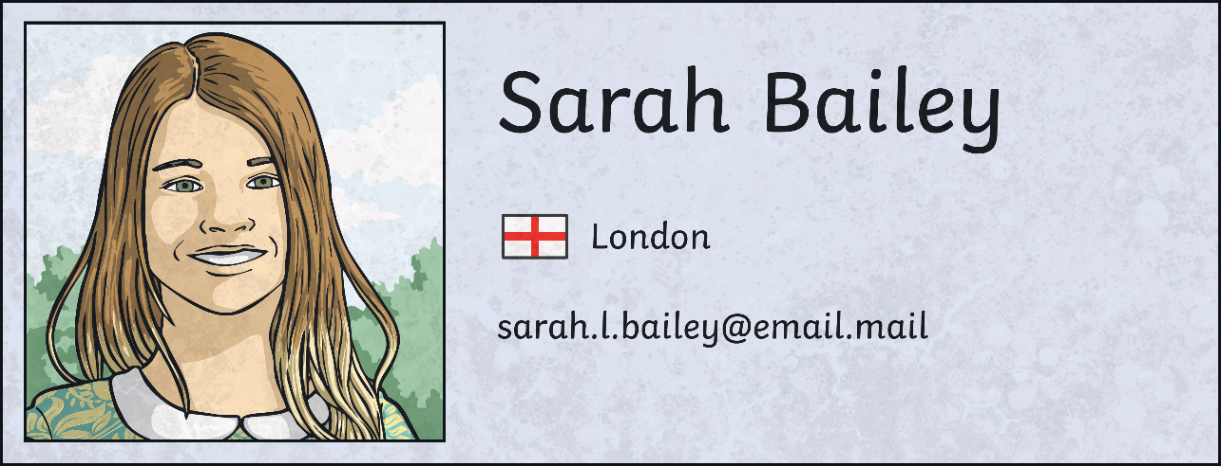
What Is Your Online Identity?
When we go online, we have an online identity.
This is information about ourselves, our likes, what we share and how we talk to others.
On some apps, we can make an avatar or a profile that other people online can see.
Watch this film from the Safer Internet Website:
Click here

Slide 10
This Is Me
What do you like to do online?
Who likes to do the same/different?
Is it OK for people to like different things online?
What could we do to make the internet better?

Slide 11
Together for a Better Internet
The theme this year asks us to work together to make an internet where we are free to be ourselves. We are #freetobeme!
When we go online, we should make sure that everyone is free to be:
Kind
Honest
Helpful
Different
Happy
Themselves
Respectful

Slide 12
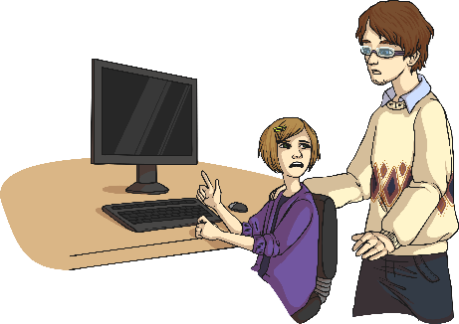
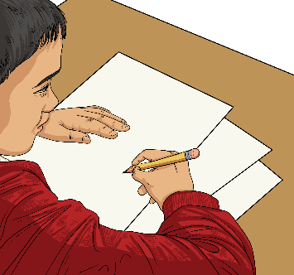
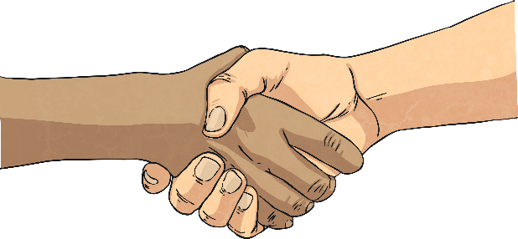
How Can We Stay Safe?
Sometimes, we might watch or read something that makes us feel sad, worried or confused.
There are lots of things we can do if this happens. We can…
tell an adult
report
save the evidence
block
help

Slide 13
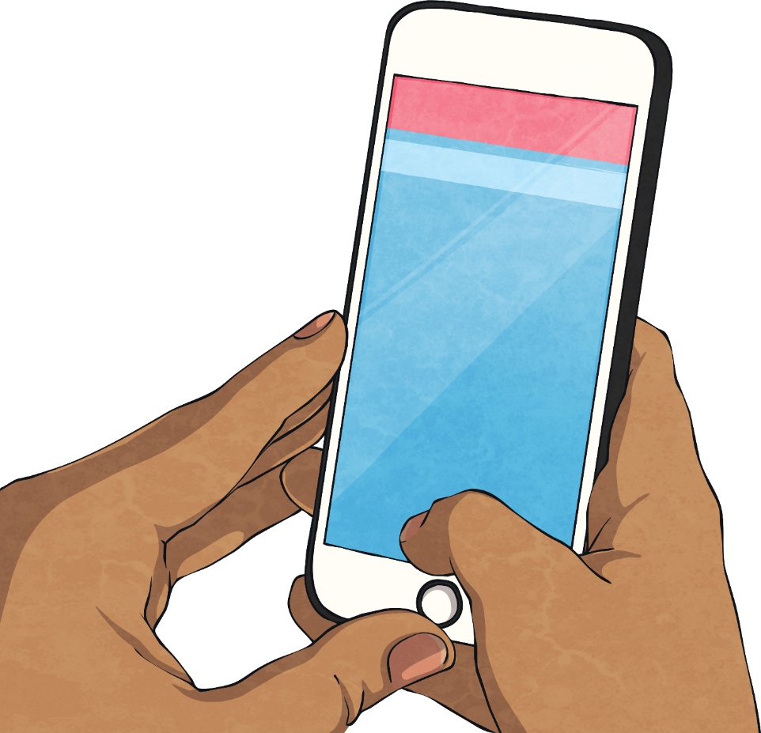
What Would You Do If…
You are in a group chat and someone else is unkind and removes your friend from the chat?
You put up a new profile picture but people make rude comments about it?
Susie is removed
You’re
ugly
Girls can’t
do this
Somebody online comments that you can’t do something ‘because you are a girl (or a boy)’?
Boys can’t
do this

Slide 14
Together for a Better Internet
Remember, we all need to work together for a safer, better internet.
tell an adult
report
save the evidence
block
help

Slide 16
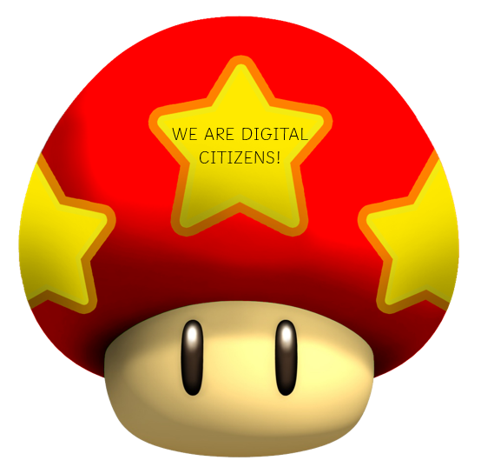

Slide 17
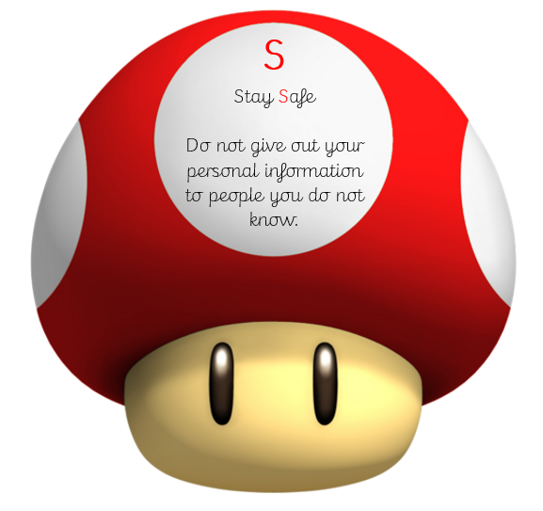

Slide 18
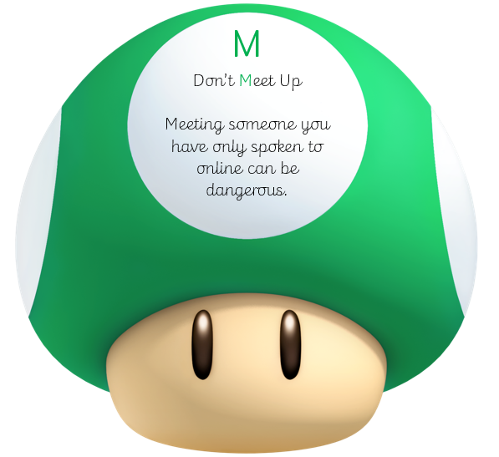

Slide 19
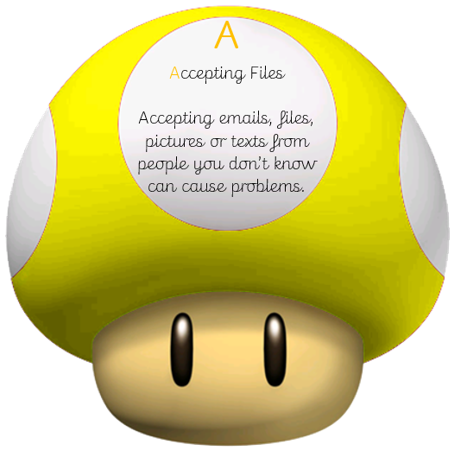

Slide 20
