Slide 2
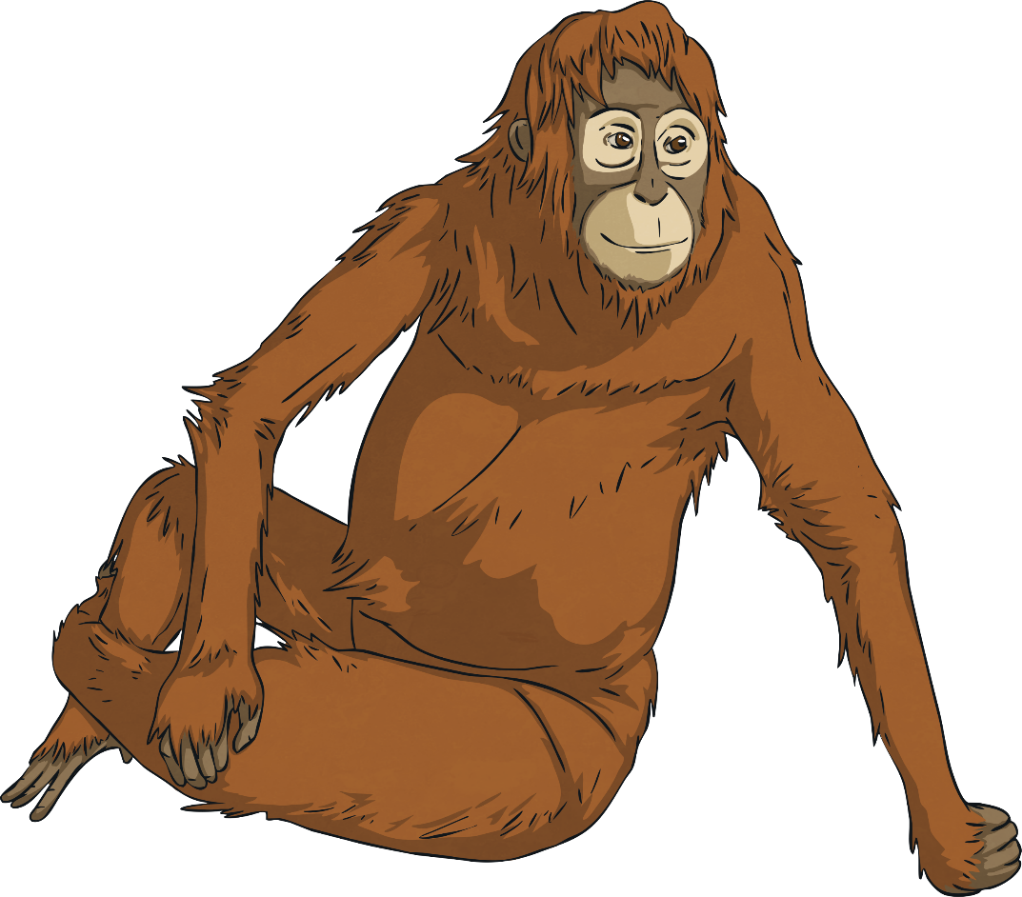
Escape the Safari Park
“Okay,” says Nicole as she gets back on the coach. “Small problem. The code isn’t working. I need some help to get the right code or we’ll be stuck inside the enclosure and it’s nearly the lion’s dinner time…”
Your class all give an excited cheer. Nicole exits the coach to enter the code on the keypad in order to gain access to the lion enclosure.
After a leisurely drive looking at the magnificent beasts, Nicole hops back off the coach to enter the code to get back out. You see a worried look appear on her face.
“Right,” says your safari guide, Nicole, through the sound system of the coach. “Now we come to one of the most dangerous parts of the park - the lions!”
It is your special end-of-year school trip; a day you have been looking forward to for ages. You are visiting a safari park.

Slide 3
Escape the Safari Park
The Rules
You can work in small groups.
When you find a clue, work together to solve the puzzle.
Write your answer down on your answer sheet.
Once you have discovered the number for the keypad, check it with your teacher to discover if you can escape the safari park!

Slide 4
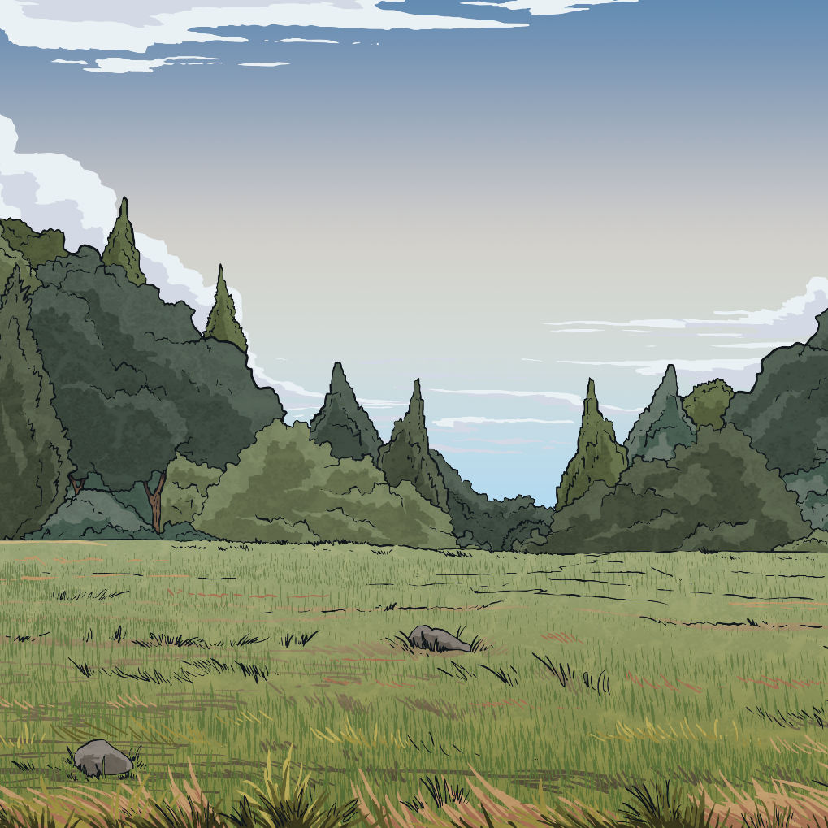
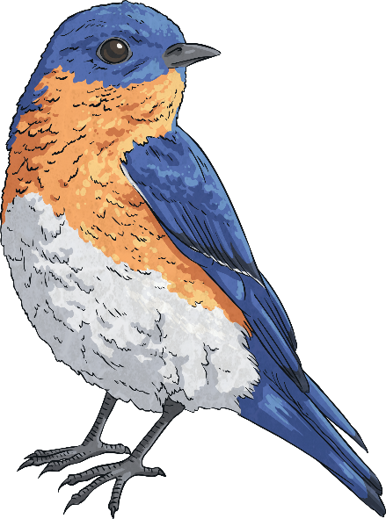
Escape the Safari Park
Answers to the Clues

Slide 5
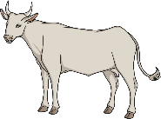
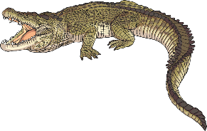
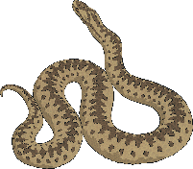
Escape the Safari Park – Clue 1
Living things can be classified into different groups.
Sort these animals into their correct groups.
Mammals | Reptiles | Fish | Birds | Amphibians
The number of mammals is the first digit on the keypad.
There are three mammals: humans, dolphins and cows.
The first digit on the keypad is 3.
3

Slide 6
Escape the Safari Park – Clue 1
Living things can be classified into different groups.
Sort these animals into their correct groups.
Mammals | Reptiles | Fish | Birds | Amphibians
The number of mammals is the first digit on the keypad.
There are three mammals: humans, dolphins and cows.
The first digit on the keypad is 3.
3

Slide 7
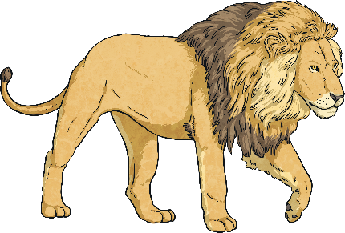
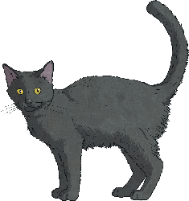
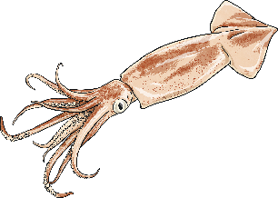
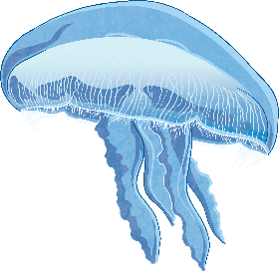
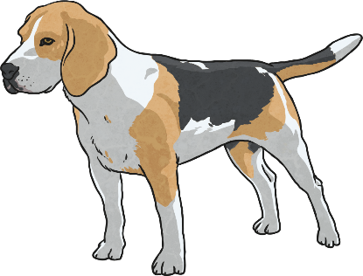
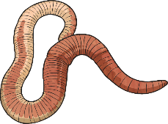
Escape the Safari Park – Clue 2
Living things can be grouped as to whether they are vertebrates or invertebrates. Sort these animals into the two groups.
The number of vertebrates is the second digit on the keypad.
The second digit on the keypad is 6.
6

Slide 8
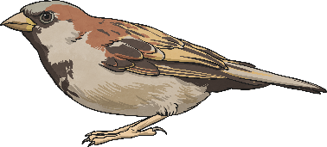
Escape the Safari Park – Clue 3
Use this classification key to work out the name of the living thing in the picture.
The number of questions answered to classify the living thing is the next digit on the keypad. The third digit on the keypad is 3.
3

Slide 9
Escape the Safari Park – Clue 4
Climate change is having a negative impact on the habitats of polar bears due to the melting of the polar ice caps. Look at this graph which shows the change in average temperatures in the Arctic.
The difference in temperature between the 1880s and 1990s is the next digit on the keypad.
The average temperature in the 1880s was 13.5°C and in the 1990s was 14.5°C. The difference is 1. The fourth digit on the keypad is 1.
1

Slide 10
Escape the Safari Park – Clue 5
Cold-blooded living things that have scales and gills.
f | i | s | h
Cold-blooded invertebrates that have no backbone, no limbs and burrow in soil.
w | o | r | m | s
Cold-blooded invertebrates that have one foot, no shell and are slimy.
s | l | u | g | s
b | i | r | d | s
Winged vertebrates that lay eggs birds
The letters spell out four.
The fifth digit on the keypad is 4.
4

Slide 11
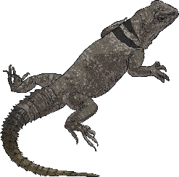
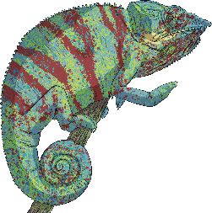
Escape the Safari Park – Clue 6
How many of these are names given to groups of living things?
The number of groups is the sixth digit on the keypad.
birds | trealop | crustaceans
parad | molluscs | arachnids
onama | amphibians | reptiles
There are six groups of living things shown: birds, crustaceans, molluscs, arachnids, amphibians and reptiles.
The sixth digit on the keypad is 6.
6

Slide 12
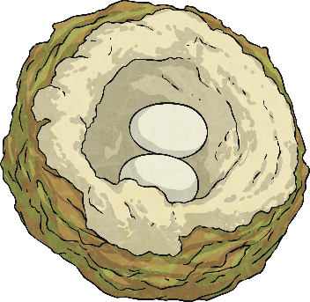
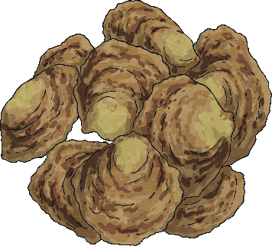
Escape the Safari Park – Clue 7
Are these statements about animal classes true or false?
Molluscs are invertebrates.
Mammals are cold-blooded.
Reptiles lay eggs.
Birds are warm-blooded.
Woodlice are crustaceans.
True
False
True
True
True
There are four true statements. The seventh digit on the keypad is 4.
4

Slide 13
Escape the Safari Park – Clue 8
Destruction of the habitats of Asian elephants has led to a decrease in their numbers.
apple trees | conifers | ferns | tulips | sunflowers | moss | roses
Plants can be classified into two sub-groups: flowering and non-flowering. Which group do each of these plants belong to?
There are four flowering plants: apple trees, tulips, sunflowers and roses. The eighth digit on the keypad is 4.
4

Slide 14
Escape the Safari Park – Clue 9
Destruction of the habitats of Asian elephants has led to a decrease in their numbers.
Decade | Number of Asian elephants
1900s | 200,000
1950s | 160,000
1990s | 50,000
2010s | 40,000
What is the difference between the population in the 2010s and the population in the 1900s? The second digit in your answer is the final digit for the keypad.
The final digit on the keypad is 6.
6

Slide 15
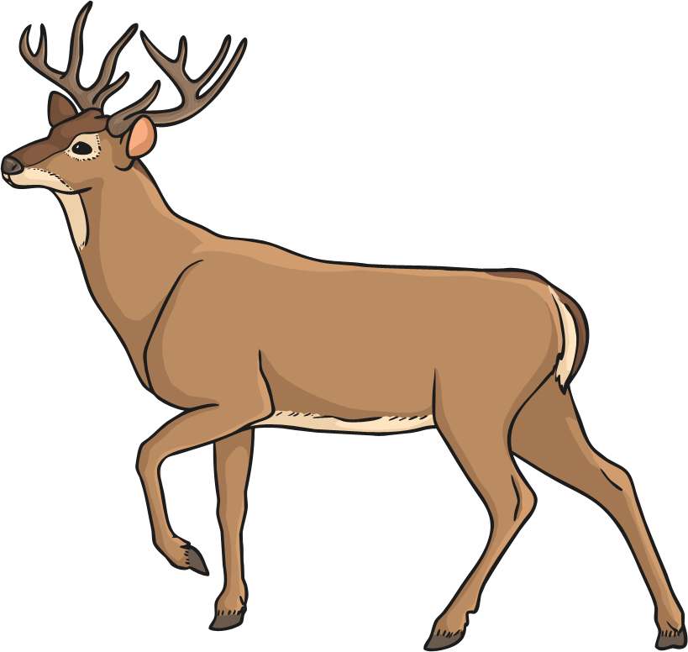
Escape the Safari Park
Now you’ve solved all the clues, it’s time to enter the code into the keypad and escape the safari park!

Slide 16
Escape the Safari Park
Digit 1
Digit 2
Digit 3
Digit 4
Digit 5
Digit 6
Digit 7
Digit 8
Digit 9
?
?
?
?
?
?
?
?
?
3
6
3
1
4
6
4
4
6
unlock
Click on the question marks to reveal each digit

