Slide 3
1) How many fingers?
2) Which set does not show 25?
a) b) c)
3) How much?

Slide 4
1) How many fingers?
2) Which set does not show 25?
a) b) c)
3) How much?
30
27p

Slide 6
Teddy is drawing a tally chart while his mum unpacks the shopping.

Slide 8
Draw a tally to represent each type of fruit
Have a think

Slide 9
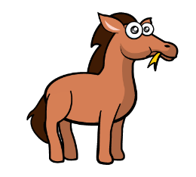
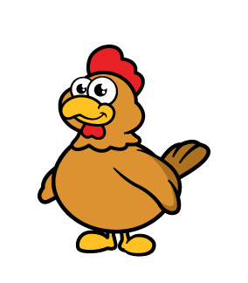
Animals | Tally | Total
Horses
Dogs
Chickens
Frogs
Sheep
1
2
7
4
9

Slide 10
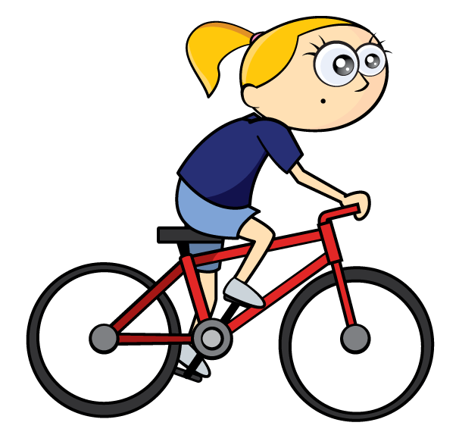
Tally
Cars
Bikes

Slide 12
Which set of fruit matches the tally chart?
a) b) c)
Fruit | Tally
apples
pears
lemons
Have a think

Slide 13
Have a go at all of the questions on the worksheet

