Slide 2
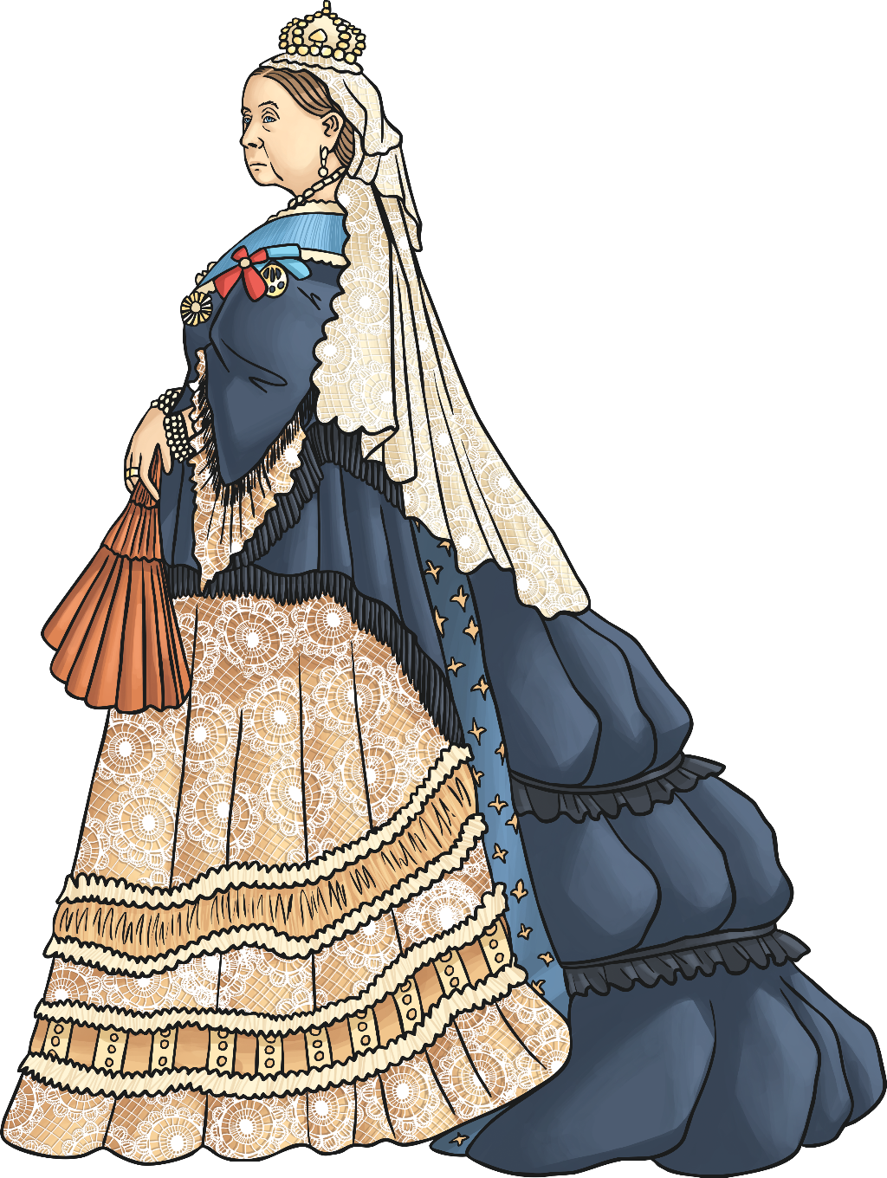
Victorian Medicine and Pharmacy
During the reign of Queen Victoria, medicine and health care changed dramatically. Doctors' surgeries, along with many of the things we are familiar with in hospitals today, started in Victorian times. Today, we will explore the exciting and dangerous world of Victorian medicine and pharmacy, looking at the important discoveries of the time and the differences they made to the lives of rich and poor people.
Can you think of any famous Victorian scientists or medical inventions that you think might have come from the Victorian era?
“Title of Image Used” by [Author] is licensed under CC BY 2.0

Slide 3
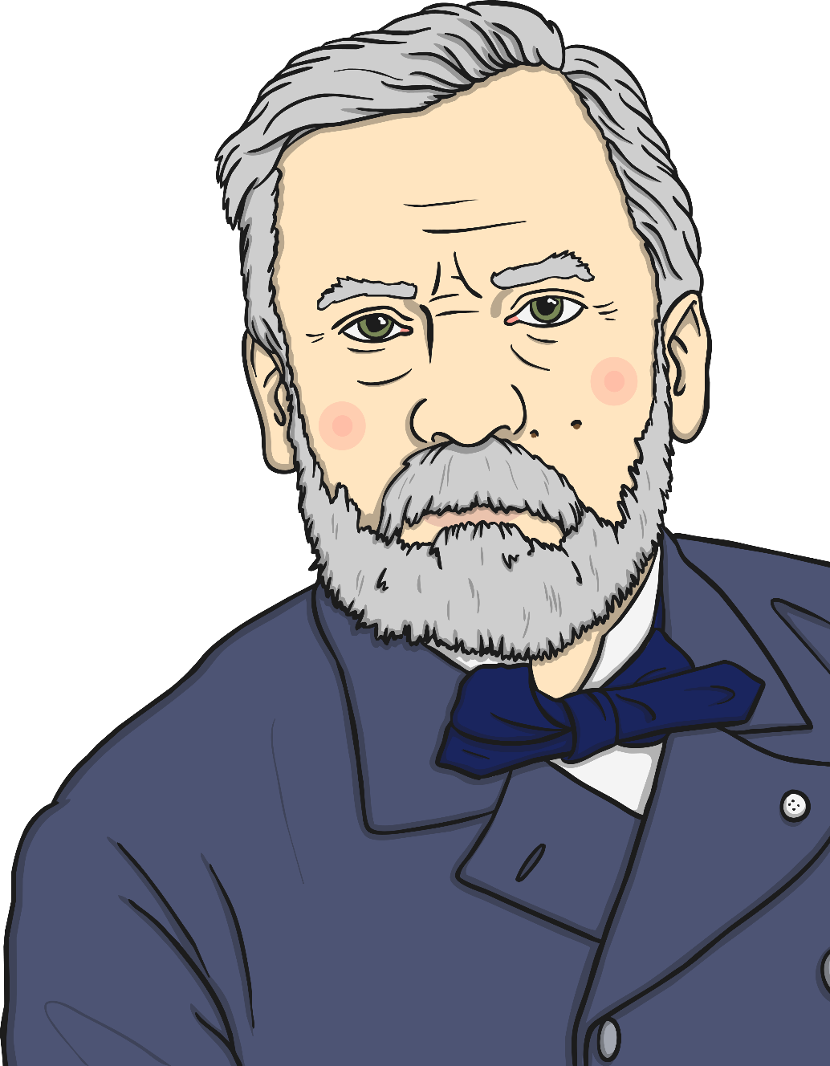
The Spread of Disease
The Victorian era was a time of scientific discovery. All over the world, famous biologists, such as Louis Pasteur and John Snow, were developing theories of germs and how illnesses spread while others, such as Florence Nightingale and Mary Seacole, were putting this knowledge into practice. Science was fashionable and developing very quickly.
Did You Know…?
John Snow managed to trace a cholera outbreak to a pump in London where people got their drinking water from. Before then it was believed that diseases came from ‘bad air’.
“Title of Image Used” by [Author] is licensed under CC BY 2.0

Slide 4
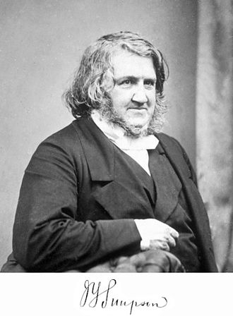
Anaesthetic
In 1847, James Simpson discovered chloroform. This was the first anaesthetic (a drug that can be used to make people go to sleep or become drowsy). It wasn’t very popular at first, as Victorian doctors believed that going through pain was an important part of being made better.
It was quite dangerous, as it was difficult to know the right amount to give someone. However, it made surgery easier to carry out and more operations worked.
Did You Know…?
Queen Victoria made anaesthesia more popular when she used chloroform during the birth of her eighth child. People thought that if the Queen used it then it must be good.
“Title of Image Used” by [Author] is licensed under CC BY 2.0

Slide 5
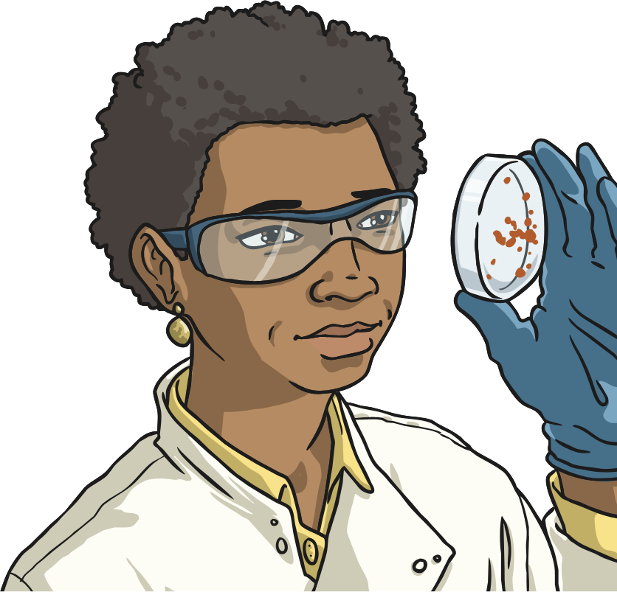
Antiseptics
Although people in Victorian times were beginning to understand that diseases were spread by germs, operations were still very dangerous. Surgeons hands, and the tools they used, weren’t always very clean and people often caught infections from them. Because of this, Joseph Lister’s invention of antiseptics in the 1890s was a vital discovery. Antiseptics are substances which kill bacteria on hands and surfaces and they greatly reduced the number of people who got infections from surgery.
We still use antiseptics all the time today. Talk to your partner, can you think of any examples?
“Title of Image Used” by [Author] is licensed under CC BY 2.0

Slide 6
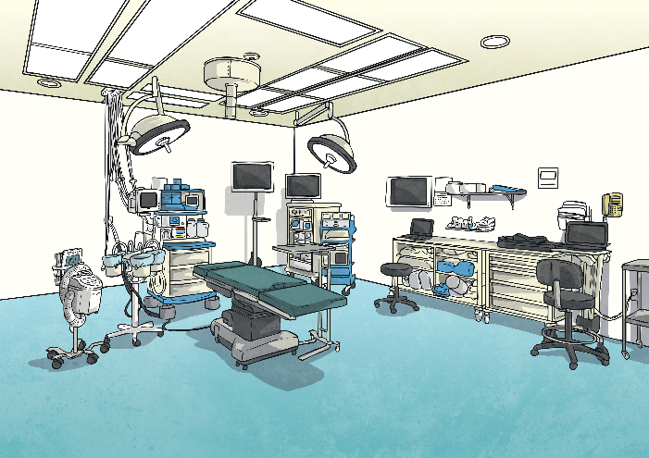
Elizabeth Garrett Anderson
Until later Victorian times, all doctors were men and women were only allowed to be nurses. Elizabeth Garrett Anderson’s ambition was to become a doctor but no medical schools in England would let her join. She learned French and went to study in Paris where women were allowed to study medicine. Even when Elizabeth passed all her exams, the British Government still wouldn’t let her register as a doctor. However, in 1876 a rule was passed to allow women to become doctors and Elizabeth was finally allowed to work. She became the first female doctor in Britain. Elizabeth also founded her own hospital, staffed entirely by women.
Why do you think all doctors were men? What was significant about Elizabeth’s achievements?
Talk with your partner and share your ideas.
“Title of Image Used” by [Author] is licensed under CC BY 2.0

Slide 7
What Is a Pharmacy?
Talk to the person next to you. What do you understand by the word ‘Pharmacy’? Why do you think that you might need to visit one?
Pharmacies, also known as chemists, are where people to go to get medicines or other healthcare items. Sometimes, a doctor might give you a prescription to take to the pharmacist to exchange for a medicine. At other times, you might go straight to the pharmacist who would be able to sell you something to help you with your problem.
Do you know what sign you would usually see outside a pharmacy?
“Green Cross - Pharmacy - Cours Mirabeau, Aix-en-Provence” by [Elliott Brown] is licensed under CC BY 2.0

Slide 8
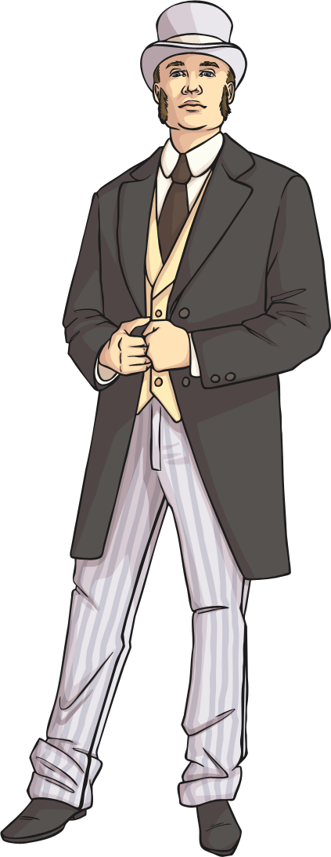
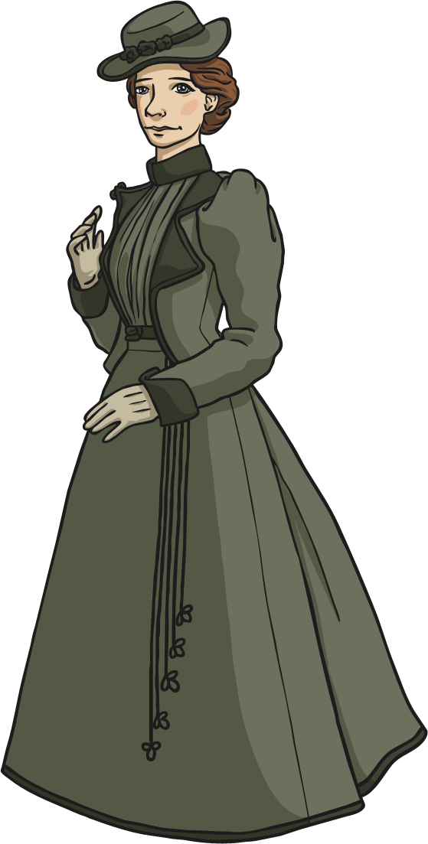
Growing Importance
It was still very expensive to visit a doctor in Victorian times, so many people would visit their local pharmacy, of which there were becoming more and more.
Before this, if you were ill, you might have been to see a botanist or even a priest.
botanist - A person who studies plants and their properties.

Slide 9
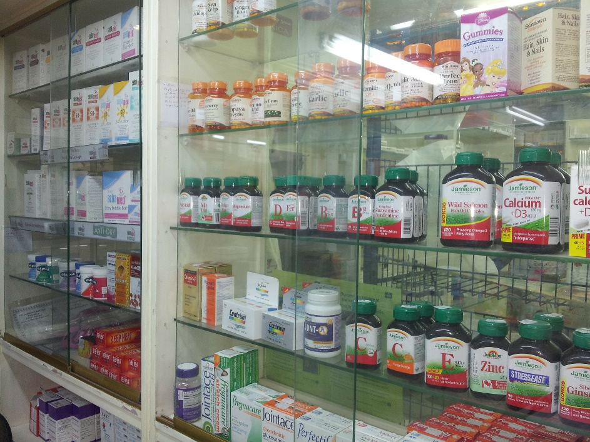
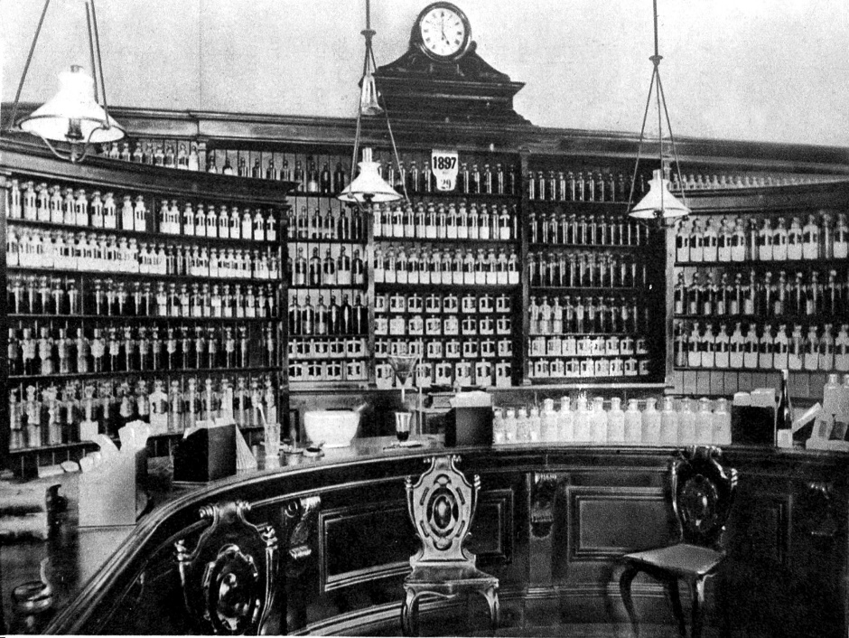
Then and Now
Look at these two pictures. One is a Victorian pharmacy or chemist shop. The other is one that you might visit today. What are the similarities and differences?
Interior of a Victorian by Wellcome London is licensed under CC BY 4.0

Slide 10
Then and Now
If you went into a pharmacy in Victorian times, lots of the medicines would be made up by the pharmacist. That is why you can see all of the bottles and drawers of ingredients.
Most medicines today are pre-packaged.
Today, there are strict rules about prescriptions. In Victorian times, doctors could just write a note to the pharmacist telling them what to give the patient.
In Victorian times, pharmacists sometimes invented their own cures to sell to people. This isn’t allowed to happen now.

Slide 11
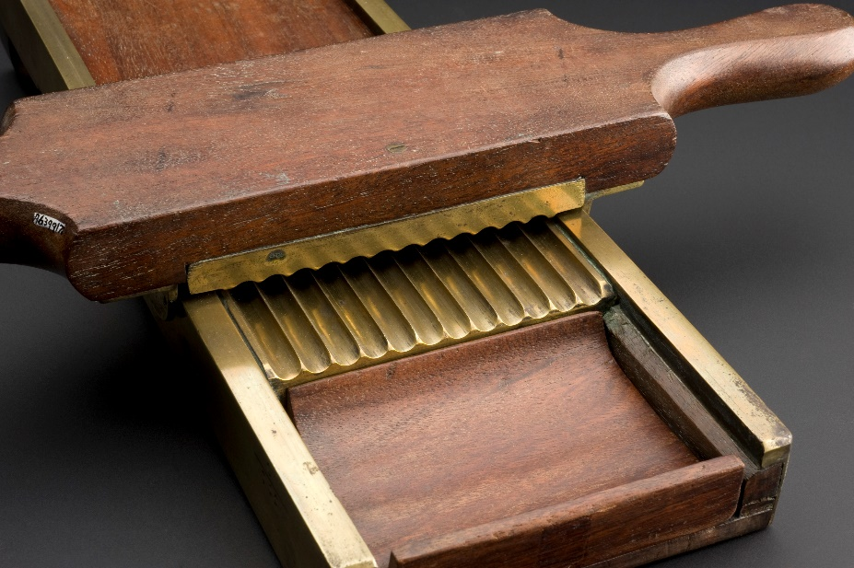
Then and Now
What do you think this machine is for? Discuss with your partner.
This is a Victorian pill cutter. The pharmacist would have made a paste, spread it in the mould and pulled the top handle to make pills which would have been collected in the tray.
Complete pill cutter in very good condition, made of mahogan Wellcome L0058535.jpg by Wellcome London is licensed under CC BY 4.0

Slide 12
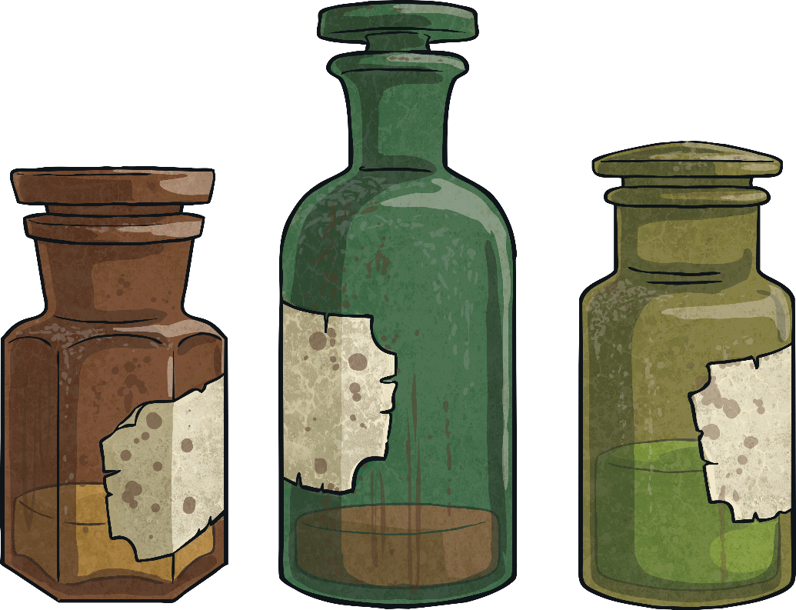
Victorian Cures
The Victorians also used to believe that blood letting (having your blood taken out using small creatures called leeches) was important to cleanse your body and keep you healthy.
Lots of the products you would find in a Victorian Chemist shop to cleanse your body would either make you vomit or go to the toilet a lot.
Today, we use the word ‘plaster’ to mean a sticking plaster. In Victorian times, it was a small piece of leather, covered in wax and oils that you stuck to the part of your body that was causing you trouble. It was believed to bring all of the ‘badness’ out of the body and make you feel better.

Slide 13
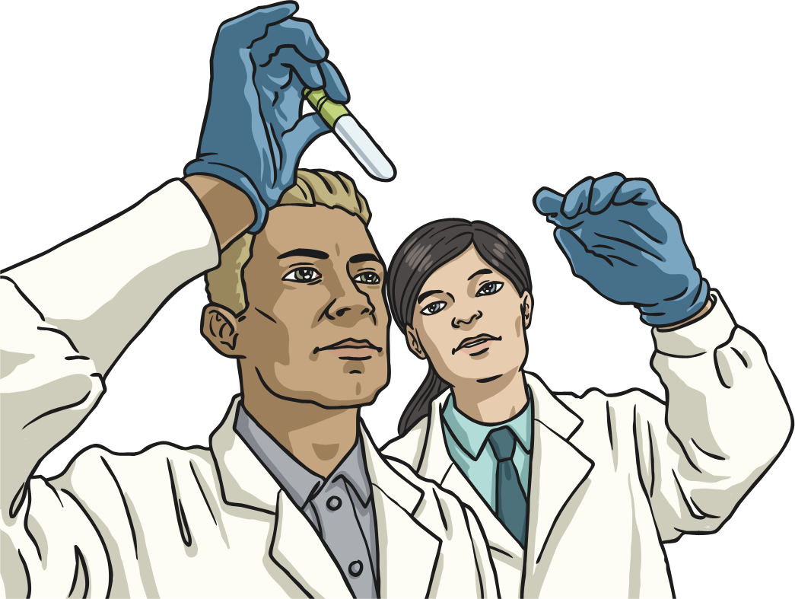
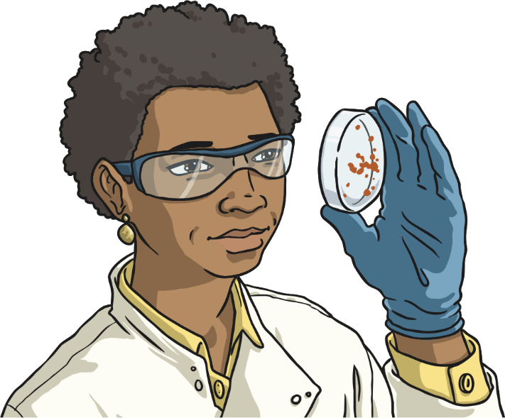
What Happened Next?
Lots of the drugs that were used in Victorian times, and given to children, had many side effects and are now illegal.
In 1908, the Poisons and Pharmacy act was passed to ensure that pharmacists were properly trained and aware of the dangers of drugs.
In 1941, the first code of ethics for pharmacists was produced. A code of ethics is a list of rules about how people in certain jobs should act.

