Slide 1
Morice Town Primary Academy “Meet the Teacher” Miss Rood Welcome to Year 1!

Slide 2
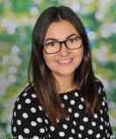
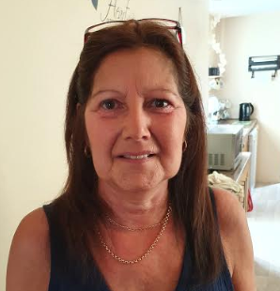
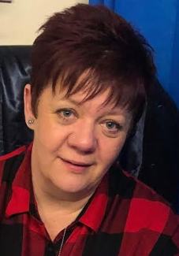
Mrs Penney
Y1 Teaching Assistant
Mrs Webb
Y1 Teaching Assistant
Miss Rood
Y1 Class Teacher

Slide 3
Information and Dates Miss Rood Mrs Penney and Mrs Webb - Class TAs Mr Twynam – PPA Teacher This year, the provision for children in Year 1 will look very similar to the provision in Foundation to support the transition and the lack of schooling due to the Covid-19 pandemic. Phonics Screening: Phonics is very important in Year One and we work toward a statutory national test at the end of Year 1 in July 2021. Further details will follow in September.

Slide 4
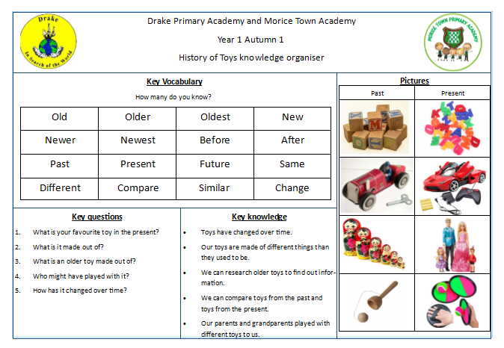
Curriculum
Our topic for the Autumn Term:
Terrific Toys!
Your children will have the opportunity to explore toys through a range of different activities. They will find out about the history of toys and how these have changed over time, comparing toys from the past to toys today. We will also explore what materials they are made from and use this in our writing.
You will receive a knowledge organiser at the start of each term to inform you what your child will be learning in more detail.

Slide 5
Home learning:
Each term we will set a range of activities for the children to complete at home and are linked to our topic. There are a range of themed activities and visits that you may wish to complete with your child which support the class topic or theme.
It is the expectation that children will read regularly at home with parents, grandparents, siblings or other family members. You can even record in their diaries if they have read to a teddy, pet or just to themselves! ☺

Slide 6
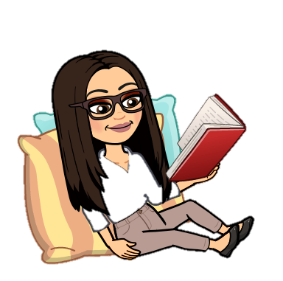
Spelling and reading books
The children are taught a new sound in their daily phonics lessons. They are given the opportunity to practise and rehearse learnt and new sounds and apply this to both reading and spelling.
New spellings for the week will be sent home on Friday and tested the following Friday. Please practice them at home as regularly as possible.
Reading books will be changed regularly when the children have read their book three times. This allows for them to increase their fluency and allows us to monitor their progress. If you read with your child, or they read to you, please record it in their diary.

Slide 7
Children, these are the Year 1 spelling words that we assess the children with. How many can you already read? Have a go over the summer holidays and impress me in September!

Slide 8
Behaviour and Rewards
Green, Orange, Red
All of the children start with their name on green for good. They move down to orange after a warning if bad behaviour continues and then on to red. If they are on red they receive a time out or miss some of their play time.
Golden Tickets
For good behaviour, being kind, helpful or working hard, the children will receive a ‘golden ticket’. This is a raffle ticket and I draw 2 names out at the end of each week and those children will win a prize! The more tickets they earn, the greater their chance of a prize.
Certificates
Children will also receive certificates in assembly for recognistion of ROARR attributes.

Slide 9
Uniform
A polite reminder that correct uniform is expected to be worn and named clearly. This includes stud earrings only, no nail vanish, no necklaces/bracelets etc and appropriate hair accessories.
PE
Our PE days are yet to be confirmed but please ensure your child’s PE kit is in school every day. This includes: a polo shirt, shorts, plimsolls or trainers.
Children may have a tracksuit bottoms for outdoor PE as the weather gets colder.
Please ensure your child has a book bag and water bottle every day.

Slide 10
Communication
Website
I will update the website as regularly as possible with information for you including dates, reminders, notes and images and summaries of what we have been up to in class.
http://www.moricetownprimary.co.uk/website/home/380553
Text messages and letters
Any formal communication will be sent out using these methods.
Open door policy
Please feel free to come and see me before or after school with any notices or queries.
My email address is year1@moricetownprimary.co.uk if you wish to contact me via email.

Slide 11
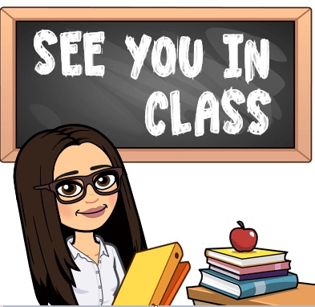
I look forward to seeing you all in September. See if you can complete any of these challenges before you come back:
Read a book with someone at home.
Count to 20 and backwards again!
Balance on one leg for 30 seconds.
Can you do it with your eyes closed?
Write a fact file all about you and bring
it in to show me in September!

