Slide 1
World War 2 Posters
IALT – Design a poster to encourage people to have a different point of view.

Slide 2
Women helping in the war.
This poster was to encourage more women to take
over men’s jobs in the war.
Some women didn’t believe it was
important.
Discuss with your partner/adult if this poster would
have encouraged you to
work in the women’s land army.

Slide 3
Women are as strong as men.
This is showing us that women can do a
man’s job they are strong
enough. They want women to believe
they can do it.
Discuss this with a partner or adult.
Would this encourage you to take the place of
a man and try?

Slide 4
This is an advert from a daily paper put in by the government. We are fighting against covid 19.
The government want to get people who are not abiding by the
lockdown laws to change their ways.
Discuss with a partner or adult. Would this poster make you start
to abide by the laws. Why would it make you change your ways
or why not?

Slide 5
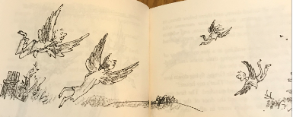
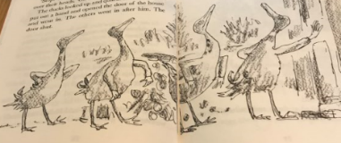
Roald Dahl wanted to change people’s mind about things with his writing.
Roald Dahl wrote Esio Trot to highlight how badly tortoises were imported and died years ago.
He also wrote The Magic Finger which was about hunting and the unfairness. In the 2 pictures below you will see how the magic finger changed hunters to ducks with wings and ducks to bigger with arms. The hunters changed the way they thought. Use the link to listen to the story.
https://www.youtube.com/watch?v=R4mpfPlAIZ0

Slide 6
My Propaganda Poster
Remember propaganda means to promote a different point of view.
Task
In your pack there is a piece of blank paper. Use this to design your own poster. Think what is important to you. What would you like people to take more seriously. You can choose a WW2 issue for your poster , Covid rules or hunting. You can choose your own topic. Here are some ideas that may help.
Conservation Global Warming
Recycling Endangered species.
Deforestation
Choose what is important to you and design your poster.

