Slide 2
Where is Dunkirk?
Dunkirk,
France
Use an atlas to see how far Dunkirk is from where you live.
United Kingdom
Netherlands
Germany
Belgium
France
Find it

Slide 3
What’s Happening Elsewhere?
It’s 1940, so the Second World War has started. The German army is currently invading Poland.
Viscount Gort is in France, commanding the British Expeditionary Force (BEF).
France has had some small, unplanned battles but has yet to have been involved in a major conflict.
Use an atlas to locate Germany, Poland, Britain and France.
Find it

Slide 4
Where Are the Troops?
German troops make a line along the west side of Germany against Belgium, Luxembourg and The Netherlands.
Use an atlas to locate the east German boundary with The Netherlands and Belgium.
United Kingdom
The French line up against the Belgian border.
Netherlands
Belgium
Germany
The British troops are in France further north.
France
Find it
Switzerland

Slide 5
Face-to-Face
United Kingdom
Until Germany entered Belgium, allied troops had to stay out. As the German forces entered, the two sides met Face-to-face.
Netherlands
Belgium
Germany
France
Switzerland

Slide 6
German Forces Break Through
The German army break through a weak spot in the allied line and surround the British and French Troops, who are in Belgium. The French soldiers on the outside can’t do anything about it.
United Kingdom
Netherlands
Belgium
Germany
France
Switzerland

Slide 7
Activation of Operation Dynamo
With the French thinking the battle is lost, Winston Churchill activates Operation Dynamo to evacuate the trapped troops from Dunkirk by boat back to England.
United Kingdom
Netherlands
Use an atlas to estimate the distance by sea from England to Dunkirk.
Germany
Belgium
France
Find it
Switzerland

Slide 8
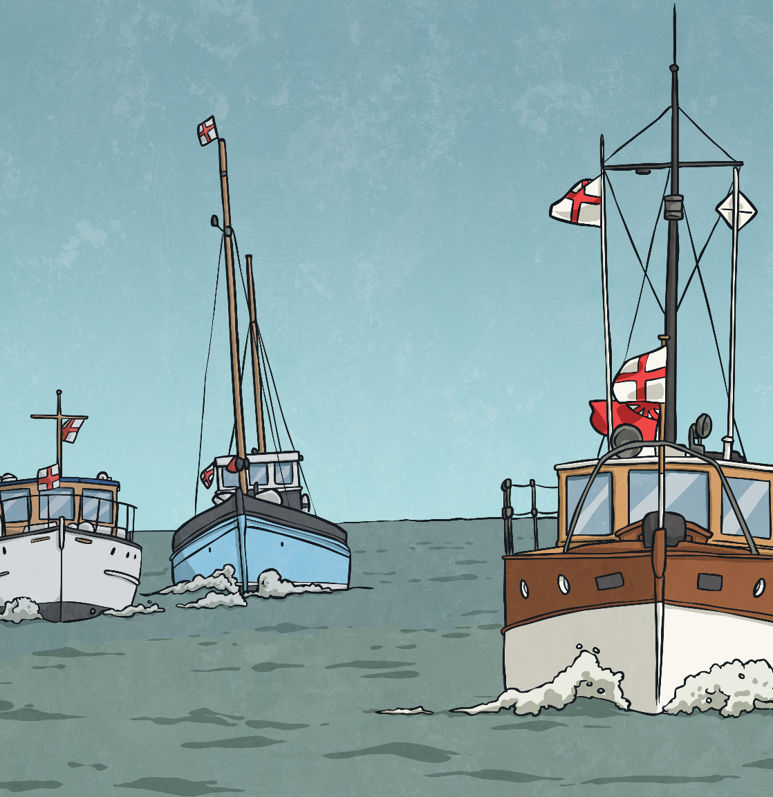
The Call for Little Boats
The problem with evacuating soldiers from the beaches at Dunkirk is that the waters are very shallow, so larger military ships can not get close enough to rescue them. This is why over 700 little ships and boats are gathered to go in and save the men.
Did you know on the 29th May, a few days after the evacuation began, it was announced to the British public? At this point hundreds more private boats came to help.
These are now known as the ‘Little Boats’.
Know It

Slide 9
Back Home
A flotilla of over 700 little ships and boats bring over 300,000 soldiers home.
Notes:
Teacher Note - You may wish to search for a news report about the evacuation of Dunkirk for your class to listen to.

Slide 10
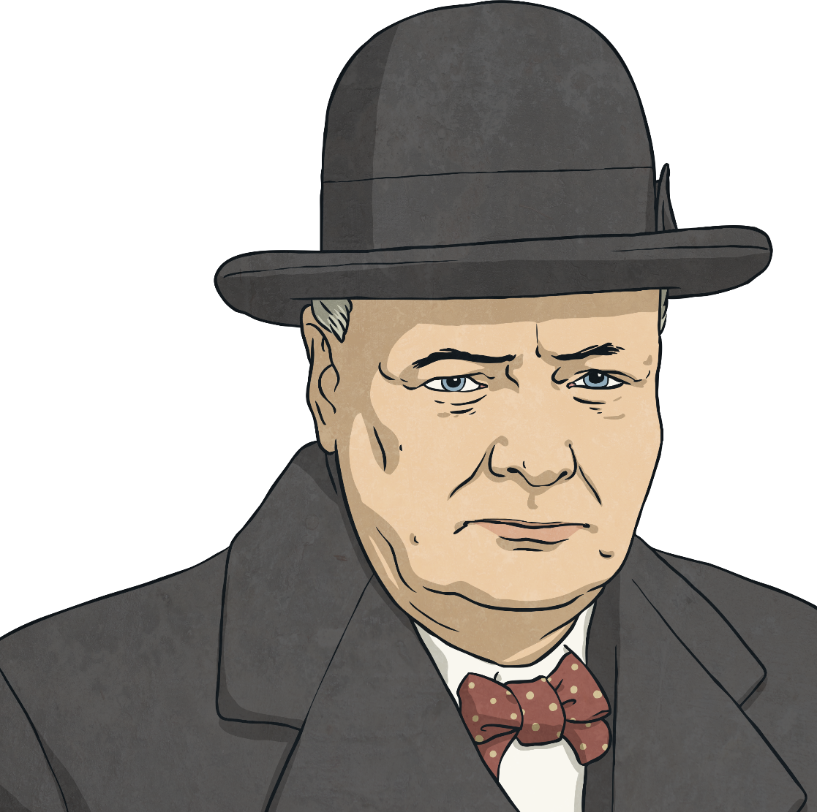
Churchill’s Speech
One of Winston Churchill’s most famous speeches including the quote, ‘we shall fight them on the beaches’ came after the Dunkirk Evacuation. It was all about staying strong and not giving in easily.
Notes:
Teacher Note - You may wish to search for a recording of Churchill's famous speech for your class to listen to.

Slide 11
The Dunkirk Spirit
The Dunkirk spirit is a phrase that is still used today and its origins lie in the Dunkirk Evacuation.
What do you think this phrase means?
What characteristics did the people in
the Dunkirk
evacuation have?
‘The Dunkirk Spirit’ means having determination in a difficult or dangerous situation. This often means helping each other and coming together as a group or community to get through difficult times such as a flood.
Think About it
Think About it

Slide 12
Glossary
flotilla a small fleet of ships or boats
troops soldiers or the armed forces
Back

